Slide 1
Representation(s) of East Timor(ese): a comparison of Portugal, the UK and Australia
John Hajek
Susana Afonso Francesco Goglia

Slide 2
Presentation plan
Some basic notions
Timorese online in UK
Timorese online in Portugal
and, in particular:
Timorese online in Australia

Slide 3
Diaspora and cyberspace
A focus on diaspora and cyberspace reveals communities as dynamic entities
Transnational relationships link members of diasporas to each other as well as to people and institutions back home.
One view is that online East Timorese are engaged in articulating and revising Timoreseness. But is that really the case?
Is there one Timorese diaspora?

Slide 4
Language and identity in the digital space
Online vs offline:
Global vs. local
Public vs. private
Through language use, speakers foreground aspects of their identity/ies in line with the new online situations in which they find themselves (Jones, 2011; Page, 2012).
Infinite number of contexts overlapping (Wesch, 2008):
Online negotiation of language use
Presentation of aspects of their identity to a variety of audiences simultaneously (Jones and Hafner, 2012: 152)

Slide 5
Are there no digital boundaries?
Online interlocutors are grounded in offline cultures defined by particular boundaries (national, ethnic, religious, etc.) (Danet and Herring, 2007)
These (typically offline) boundaries might be present in online identity construction.

Slide 6
East Timorese pages in the UK
Timorese associations’ projected symbols of Timoreseness:
National celebrations
Religion
Traditional dance, costumes and crafts
Football (Martin-Jones and Cabral, 2015)
British traditions celebrated by Timorese (e.g. Halloween)
Flag and tais are very pervasive symbols
Struggle for independence is also featured
Issue with oil and Australia also features but not primary

Slide 7
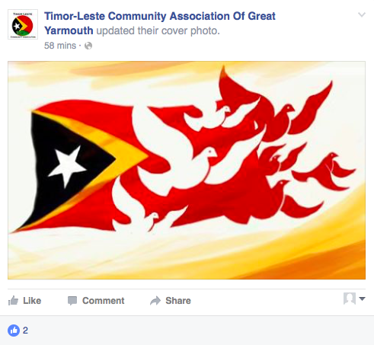
Flags, tais and religious iconography

Slide 8
Online confirmation of cultivation of East Timorese memory and history

Slide 9
Local integration: Halloween

Slide 10
East Timorese page in Portugal
Académicos timorenses de Coimbra
High level of Portuguese online – limited use of Tetun.
Specifically Timorese identity is most evident in repeated images of cultural traditions, e.g. traditional dance in traditional dress

Slide 11
Australian context: the ET born
‘Large’ established East Timorese community
Overwhelming bulk of East Timorese born arrived as refugees (directly or via Indonesia or Portugal)
New (very) small wave: East Timorese students
They are divided into 2 major groups
Timorese Timorese (Timor oan)
Chinese Timorese

Slide 12
Year of arrival in Australia

Slide 13
TECC Vic

Slide 14
TECC Vic

Slide 15
Chinese x Timorese crossing over: soccer

Slide 16
Soccer pt 2
Notes:
Repost only in English

Slide 17
Timorese community in Darwin

Slide 18
Timorese Community in Darwin

Slide 19
Timorese Community in Darwin – religious notice

Slide 20
Timorese Community in Darwin

Slide 21
Timorese community in Darwin

Slide 22
Timorese Community in Darwin

Slide 23
METAC (Melbourne East Timorese activity centre)

Slide 24
Australia’s very different ET diaspora

Slide 25
Language at home

Slide 26
Chinese Timorese in East Timor
In Timor: kept distinct in Dili (Hakka, own school, educated in Mandarin, and later also obligatorily with Portuguese). Limited mixing (mostly in outlying areas)
Timor’s commercial class (97% of all businesses)
Linguistically very visible and audible – distinct Tetun, use of Chinese characters and naming practices
Mass refugee arrival in Australia (1976-1979)

Slide 27
An online comparison: different vantage points
Australian Timorese Chinese community – inward facing, self-reliant, apolitical, no use of Timorese symbols, language, etc… (except in soccer – clearly related youth related)
Australian Non-Chinese Timorese – outward looking, activist oriented, English-oriented
British Timorese – partly inward facing, self-reliant, use of Timorese symbols, language

Slide 28
Offline reflects online and vice versa
Timorese Chinese community – inward facing, self-reliant, apolitical, little or no use of Timorese symbols, language, etc…
(distinct community – originally imposed
and now maintained)
• Non-Chinese Timorese: integrated in Australia and ET – the East Timorese involved are often highly educated and mobile – to and from ET

Slide 29
Language transitions and identity
(1) Chinese Timorese: Hakka, Tetun ~ Portuguese, other ET languages
In Australia: Hakka > English
‘Timor’ not foregrounded
(2) non-Chinese Timorese: Tetun and other languages, Portuguese, Indonesian
In Australia: Portuguese > Tetun (new LF) > English
‘Timor’ foregrounded

Slide 30
Concluding remarks
Looking online allow us to look backwards, sideways and forward online and offline to understand both online and offline – with unexpected results.
The communities in the 3 countries are very different. They reflect different histories in Timor (Chinese v non-Chinese) as well as different chronologies (post-1975 v post-2000), different migration types (refugees v work seekers) and different degrees of integration (Portugal vs Australia vs UK).

