Slide 1
East Timorese online language practices (crossing borders)
Susana Afonso (University of Exeter)
Francesco Goglia (University of Exeter)
John Hajek (University of Melbourne)

Slide 2
Presentation plan
- Mutilingualism in the immigration context
- Linguistic cybercology
- Situating the East Timorese diaspora
- Online language practices: discussion of examples
- Concluding remarks and questions

Slide 3
Multilingualism in the immigration context
- Language repertoires are reshaped and different languages (or rather "specific semiotic resources" Blommaert, 2010: 102) come in contact in different contexts
- The language repertoires change according to the ecology they find themselves in (UK, Australia, Portugal)
- Transnational nature(s) of immigrant groups (e.g. East Timorese are Portuguese citizens in Europe, but not in Australia)
- Today there is a new virtual language ecology which blurs boundaries between previously separated physical environment (speakers are now able to speak, read and write at any time in any place)

Slide 4
Linguistic cybercology (Ivkovic and Lotherington, 2009)
Languages coexist and are used in the digital space:
Single plurilingual environment
Global scale
Transcends geographical boundaries
Physical and social cues are reduced
Language (patterns of) use will be dependent on the virtual environment (cp. Haugen’s (1972) language ecology).
Are language repertoires reshaped in the same way online and offline?

Slide 5
Situating the East Timorese diaspora
UK
- Mostly young workers (before 2005 Timorese had to go to Portugal first to get their Portuguese passport. Since 2005, they are able to obtain Portuguese passport in Dili and then travel directly to UK)
- Oldest communities established around 1998 (Oxford)
- New communities established in the last 10 years (e.g. Bridgwater and Shepton Mallet, Somerset)

Slide 6
Situating the East Timorese diaspora
Portugal
Established refugee community since 1976 onwards, new student community since 2002
Australia
Established refugee community since 1975 with high mobility to and from East Timor
Italy
Small religious community mainly based in Rome

Slide 7
Data
Open and/or public Facebook pages in four countries: Portugal, UK, Australia, Italy
Facebook is static and dynamic (mostly written, but also visual and audiovisual), permanent and editable, synchronous and asynchronous.
We did not look at individual Facebook pages for this part of the study.
Small and varied number of East Timorese group sites across the 4 countries – greatest concentration in the UK

Slide 8
Language use – facebook titles in open groups
UK community pages:
4 have English names
1 has a Tetun name
2 have Portuguese names
Australia community pages:
All 5 have English names
Portugal: 1 Portuguese only
Italy: 1 Tetun 'Komunidade Timor oan iha Italia’

Slide 9
Use of Tetun and Portuguese in posts
FORMAL ANNOUNCEMENTS AND
INIVITATIONS IN TETUN AND
PORTUGUESE

Slide 10
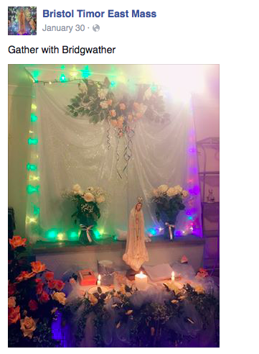
Use of English

Slide 11
Mixed utterances
Portuguese (tabom; pa) and Tetun
Fataluku and Tetun (kampanha)

Slide 12
Code alternation
FORMAL ANNOUNCEMENT IN TETUN
ENGLISH COMMENT BY AN EAST TIMORESE

Slide 13
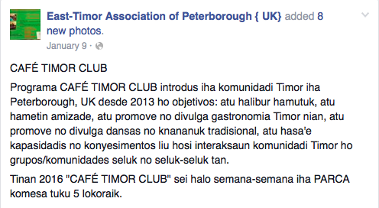
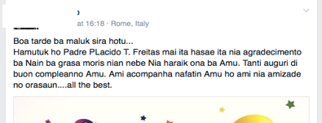
Code alternation
ANNOUNCEMENT IN TETUN
ENGLISH/ ITALIAN

Slide 14
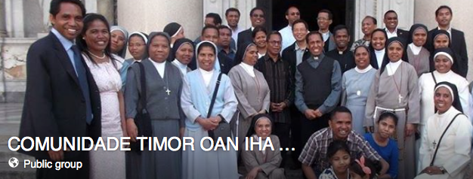
Code alternation
Italian
Tetun (or Portuguese?)

Slide 15
Religious "lect"
Rogai por nós – ‘pray for us’
Rogai, 2PL – disappeared from standard Portuguese;
Dialectal OR used in church
ciascuna – ‘each one’ (female)
“Tutti e tutte/ ciascuno e ciascuna” very much associated to religious contexts (what a priest would say”

Slide 16
Code-switching
Abraços (Portuguese)
?
INDONESIAN (different versions, though)

Slide 17
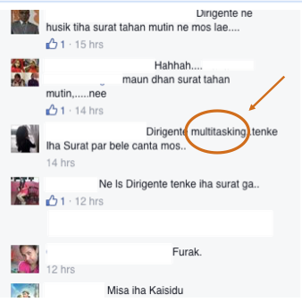
Code-switching

Slide 18
Calque
Portuguese: dar um toque (give me a ring)
Interesting/ interested -
Only one form is used as the adjective

Slide 19
Concluding remarks and questions
Facebook is a very rich environment in which we can observe truncated repertoires because language is used spontaneously
These examples can also be analysed through the lens of the virtual linguistic landscape which delineates "power relations among the coexisting linguistic choices in the cyber space community" (Ivkovic and Lotherington, 2009: 19):
- English clearly dominates in the Australian context
- Portuguese in the Portuguese context
- Portuguese and Tetun are most visible in UK
- Italian and Tetun/Portuguese are most visible in Italy
- The national languages and Indonesian barely present

Slide 20
Concluding remarks and questions
Wide range of linguistic phenomena can be found (not surprising given the nature of the virtual realm) - and great difference between countries
The boundary between fragment languages is often blurred viz-à-viz Portuguese and Tetum, e.g. obrigada e igualmente, bom susessu
Standardization strongest for Portuguese and English – Tetun shows more variability, e.g. spelling
Fragments are often reduced in meaning and phatic-like (Miller 2008), e.g. amen, all the best, furak losss, etc.... Not indicative of language capacity of their authors.
The religious lect is a new dimension in Timorese languaging online worth further exploration

