Slide 1
Using Mixed Methods in Adult Literacy Research in Timor-Leste
Research questions, methods and instruments
Danielle Boon and Jeanne Kurvers
Tilburg University, the Netherlands

Slide 2
(part of) Research program April 2009 – April 2014 BECOMING A NATION OF READERS: Language policy and adult literacy development in multilingual Timor-Leste
Tilburg University: Sjaak Kroon, Jeanne Kurvers, Estêvão Cabral, Danielle Boon, Edegar da Conceição Savio,
University of Birmingham: Marilyn Martin-Jones
Leiden University: Aone Van Engelenhoven
National University of Timor Lorosa’e: Benjamim de Araújo e Corte-Real
NWO-WOTRO Science for Global Development W 01.65.315.00

Slide 3
Study 1 Critical-historical study on adult literacy in Timor-Leste, 1974-2002 (Estêvão Cabral)
Study 2 Adult literacy acquisition, education and use in multilingual Timor-Leste (Danielle Boon)
Study 3 Fataluku language development and adult literacy (Edegar da Conceição Savio)

Slide 4
Adult literacy in Timor-Leste Research questions about:
adults learning to read and write
the teaching of reading and writing to adults
the use of reading and writing ability by adults

Slide 5
Research questions about learning
1. What are results achieved in learning to read and write in Tetum in the available adult literacy programs?
2. What factors are most important in the development of adult learners’ literacy ability?

Slide 7
Research questions about teaching
3. What classroom-based literacy teaching practices are adult literacy learners confronted with?
4. What ideas guide teachers’ practices?
5. What works?
(Which teaching methods/practices are most effective/motivating?)

Slide 8
Research questions about uses and values
6. What literacy uses do adult learners report with reference to different social domains?
7. What literacy values do adult learners report with reference to different social domains?

Slide 9
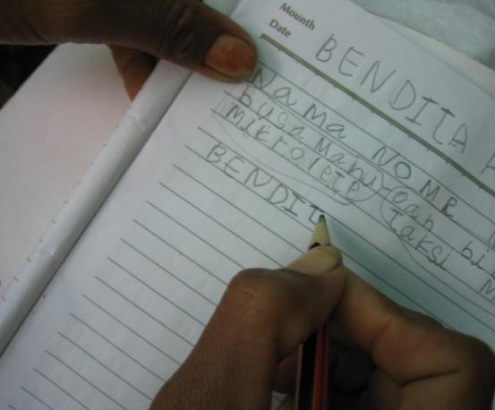

Slide 10
Research questions about learning
Question | Method (of data collection) | Instruments
1. What are results achieved in learning to read and write in Tetum in the available adult literacy programs? | Survey: Testing of reading and writing ability | Reading and writing tests: Grapheme recognition Word reading Form filling Word writing
2. What factors are most important in the development of adult learners’ literacy ability? | Survey: Asking about factors that possibly influence reading and writing acquisition Case study: Observing classes | Questionnaires for teachers and learners Observation checklist

Slide 11
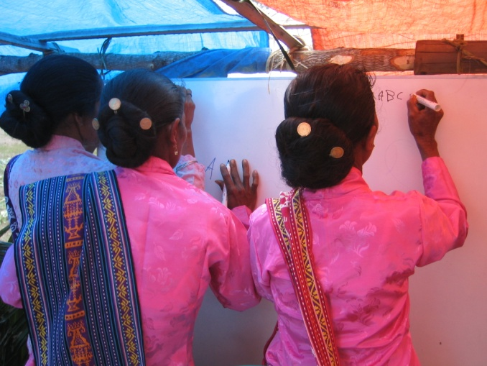

Slide 12
Research questions about teaching
Question | Method | Instruments
3. What classroom-based literacy teaching practices are adult literacy learners confronted with? | Case study: Class observation | Observation checklists Still photography Audio recordings
4. What ideas guide teachers’ practices? | Case study: Interviews based on what was seen during observations | Interview guidelines

Slide 13
Question 2: What factors influence adult literacy learning? Question 5: What works? Investigate relationships between
through statistical analysis
results
information
on possible
factors of influence
on learning

Slide 14
Statistical analysis
Kind of analysis | To do what
Frequency analysis / crosstabs | Describe reading ability, uses, teaching practices (for different groups)
Correlational analyses | To calculate relationships, for example between age and reading ability
T-test /Analysis of variance (Anova) | To calculate differences between two or more groups (for example men and women (t-test), three literacy methods
Mancova | Like Anova, but to control for one or more factors (for example gender and years of schooling)
Regression analysis | More advanced technique to predict the most important factors that influence results

Slide 15
Research questions about uses and values
Question | Method | Instruments
6. What literacy uses do adult learners report with reference to different social domains? | Case study: a) Observations of people using literacy in daily life b) Interviews c) Linguistic landscape study | a) Observation checklists b) Interview guidelines c) Still photography of written text in the public sphere
7. What literacy values do adult learners report with reference to different social domains? | Case study: Interviews | Interview guidelines

Slide 16
Combining
Quantitative research
Qualitative research

Slide 17
Investigate relationships between answers to RQ 1-7
RQ 1-2
results on learning
RQ 3-4-5
results on teaching
RQ 6-7
results on use

Slide 18
Data triangulation
Results on
teaching practices 1:
What researcher observed in class
Results on teaching practices 2:
What manual and teachers told you about teaching
Results on
teaching practices 3:
How students experienced teaching

Slide 19
Research questions study 3 (Edegar da Conceição Savio)
1. How is Fataluku developing from an endangered oral language into a protected written language?
What are the issues emerging in this process?
2. What changes are taking place in the sociolinguistic landscape and the language values in the Fataluku-speaking areas of rural Tutuala and urban Lospalos?
3. What is the position and the use of Fataluku within existing adult literacy programs?
Notes:
The first question is the focal point of interest of Aone van Engelenhoven, PhD, the second and third of Edegar
The focus of this presentation is on research question two: the sociolinguistic landscape in the Lospalos area of Lautem.

Slide 20
Methods and instruments - Study 3
Document analysis: Policy documents, constitution, government decree, etc.
Survey: Questionnaire for interviews with Fataluku speakers and experts on uses and opinions regarding Fataluku
Case studies in two adult literacy courses in different community contexts
Mapping of linguistic literacy landscape (by photographing visible language): Collection of examples of written Fataluku and other languages
Notes:
Presentation today mainly about survey and linguistic landscape
The survey data in Lospalos are collected during field visits in June-Aug. 2010
Data in Tutuala will be collected next month (July 2011)
The main parts of the questionnaire:
oral and written proficiency in languages,
uses of spoken and written languages in different domains and with different people (for illiterates questions about asking help in reading and writing from whom, for what),
attitudes about literacy and Fataluku (as a language of literacy),
background data of the participants.
All interviews were conducted orally by Edegar with the use of (partially) precoded questionnaires that were available in Fataluku, Tetum or Indonesian (and English for us). Participants could choose the language they preferred to talk with the interviewer.
Photographs of writing samples until now mainly collected in Lospalos, partly in Tutuala.

Slide 21
Any questions?

Slide 22
And now your research questions…!
Thank you.

