Slide 1
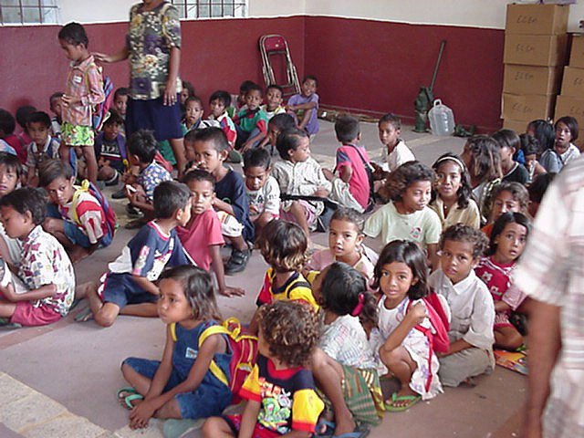
Mother-tongue based multilingual Education in East Timor: THE LANGUAGE POLICY BACKGROUND
KERRY TAYLOR-Leech, griffith university

Slide 2

ABC Documentary “East Timor: Pupils embracing mother tongue”
Notes:
(8 minutes): http://www.youtube.com/watch?v=Ft6Y5bSARyU

Slide 3
The National Constitution 2002
Tetum and Portuguese are co-official languages.
Tetum and the other indigenous vernacular languages are national languages “to be protected and valued by the State”.
Indonesian and English are “working languages in civil service side by side with official languages for as long as deemed necessary.”
“Privileged ties” with Portuguese-speaking countries.
Notes:
At independence, the 2002 National Constitution conferred co-official status on Portuguese, the former colonial language, and Tetum, the indigenous lingua franca. The Constitution also adopted Indonesian and English as working languages. Tetum and the vernaculars were given the status of national languages, to be protected and valued by the State.
The Constitution also privileges the relationship with the Portuguese-speaking world. Timor-Leste became a member of the Community of Portuguese-Speaking Countries (the CPLP) in 2003.

Slide 4
Multilingualism in Timor-Leste:
2010 census (p.XVIII)
L1s: The national languages: 32 indigenous vernaculars listed in the census. Language ability was self-reported.
Some people are monolingual in L1. Many others are multilingual.
L2/3: Tetum for most people (L1 for about 36%) (*56.1%).
L3/4: Portuguese (25.2%) and/or Indonesian (45.3%) depending on age.
L5: English (14.6%)
*percentage of persons 15 and over who are literate (can speak, read and write)

Slide 5
Under performance: The effects of long-term disadvantage
2002: 57% of adults had little or no schooling and only 23% had a primary education.
2010:
11% of children in pre-school.
70% net primary school enrolment.
30% of children not attending primary school.
79% mean youth literacy rate.

Slide 6
Low enrolment, grade repetition and high dropout
At least 70% of students do not reach Grade 6, let alone complete primary education.
Most dropouts before Grade 2.
Grade 9 enrolments stand at less than a quarter of those in Grade 1.

Slide 7
Language of instruction (LOI) policy shifts - submersion to transition schooling
2002: Portuguese the sole LOI.
2004: 5 h a wk of Tetum and 3 h of Portuguese as subjects in Grades 1 and 2 to 6 h a wk of Portuguese and 2 hours a wk of Tetum by Grade 6.
Teachers consistently directed to prioritise Portuguese. Tetum could be used as a ‘pedagogic aide’.
2005: Teachers allowed to use Tetum as LOI in Grades 1 and 2.

Slide 8
2006-7 crize. Post-crize policy shifts to Early-exit bilingual schooling
2008: Teachers’ language use should shift from roughly 70%Tetum and 30 % Portuguese in Grade 1 to 100% Portuguese by the end of Grade 3.
From Grade 4, Portuguese the LOI and the only written language.
Tetum to be used for oral instruction only.

Slide 9
Basic Education Act 2008 (9 years compulsory, free basic education language policy goals
Guarantee mastery of Tetum and Portuguese.
First foreign language, English - to be taught from Grade 5.
Develop knowledge and appreciation of the official and national languages.

Slide 10
2011 Basic education curriculum reform document
The teaching of Tetum as subject takes priority between Grades 1 and 3 (3-4 periods a wk).
The teaching of Portuguese takes up more curriculum time (5 periods a week) in Grades 7 - 9.
English may be introduced in Grades 5, 6 or 7 according to the capacity of the school.
All subject-based assessment is in Portuguese.

Slide 11
2011-2030: The Timor-Leste Strategic Development Plan (i)
To improve access to education and build a solid foundation for future literacy and numeracy in both Portuguese and Tetum, local languages will be employed as languages of teaching and learning in the first years of basic education, providing a smooth transition to the acquisition of Timor-Leste’s official languages, in accordance with the recommendations of the mother tongue-based multilingual education policy for Timor-Leste (TLSDP, 2011, 16).
Notes:
The Timor-Leste Strategic Development Plan is a package of strategic social policies that include educational development planning for 2011-2030.

Slide 12
2011-2030: The Timor-Leste Strategic Development Plan (ii)
Given the diversity of national and local languages in Timor-Leste, the National Education Commission has initiated studies on mother tongue-based multilingual education for Timor-Leste. These studies aim to ensure that children are not disadvantaged and that all have equal access to an education, providing a smooth initial transition to the acquisition of Timor-Leste’s official languages (TLSDP, 2011, 25).

Slide 13
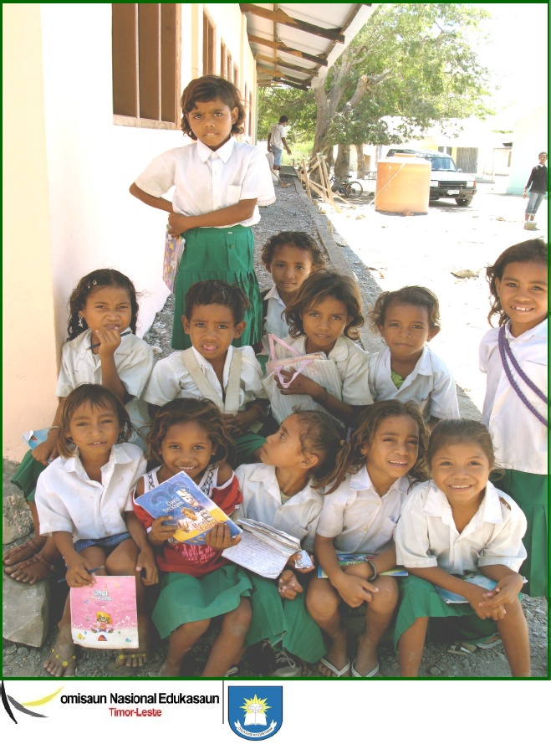
2011 Mother tongue-based multilingual education for Timor-Leste (MTB-MLE)
Notes:
In 2010 the National Education Commission was mandated by the Minster of Education to produce policy guidelines for the use of the national languages in education. A working group was set up and a series of consultations with international experts carried out. The resulting document is the MTB-MLE policy for Timor-Leste. This document contains some of the most radical proposals for the use of vernacular languages in education in SE Asia to date.

Slide 14
MTB-MLE recommendations (i)
L1s: The national languages are LOIs from pre-primary education to end Grade 3 and taught as subjects from Grade 4. In some schools Tetum is L1.
L2: Tetum used orally by teachers in pre-primary schools; introduced bilingually with L1 and as a subject in Grades 2 and 3; and taught until the end of basic education.
L3: Portuguese introduced in Grade 4 bilingually with L1 and L2 and taught until Grade 9.

Slide 15
MTB-MLE recommendations (ii)
L4: English taught as a foreign language from Grade 7 Grade 5 where possible).
L5: Indonesian taught as an elective in Grade 7.
At lower secondary level, Portuguese and Tetum are languages of instruction.

Slide 16
2012 Demonstration schools
Introduce national languages in willing pre-primary “demonstration schools” linked to primary schools where there could be L1 teaching by Grade 3 in 2013.
Notes:
The demo schools were scheduled to commence in 2012 in three districts.

Slide 17
Teaching assistants
Where qualified teachers do not speak the community language, they should be supported by local teaching assistants who know the language and can help provide oral explanations to the children.

Slide 18
Councils for the promotion of mother tongues and the INL
Community representatives work with linguists and teachers to develop orthographies for reading and teaching in the national languages.
The National Institute of Linguistics produces vernacular orthographies and other linguistic resources, e.g. dictionaries.

